Slide 1
Face Mask Detection And Proximity Sensor
Presented by
Temitope Badekale

Slide 2
Introduction
The purpose of the project was to develop a model that will help implement covid-19 policy like use of face mask and keeping 6ft apart in public places(mall, library )
I made use of python to build the model , the primary packaged I used in python are tensorflow and Opencv
The model was made using Deep Learning

Slide 3
Model Building
Face detection Model
Mask Detection
Model
Distance Calculation
Data Sourcing
(faces with and without mask)

Slide 4
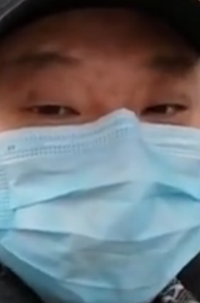
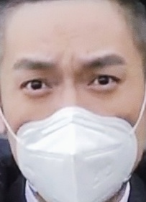
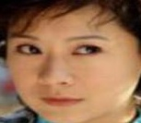
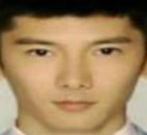
Model Building
Data Sourcing
Faces with mask
Faces without mask
1915 pictures
1918 pictures
Image Data Generation was also used on the image
Notes:
Image data generation help in change the orientation(rotation , size, proportion) of the image
so that the model will not be confused in predicting life image

Slide 5
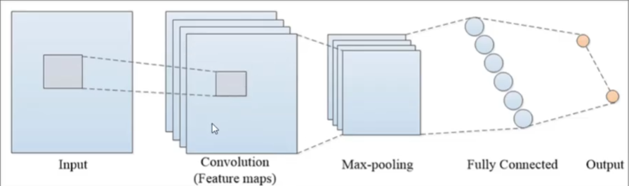
Model Building
Convolutional Neural Network
Notes:
Cnn was used because I am build a model to predict faces. Moblenet ,
Gan can also be used in image processing.
Max pooling – reducing image size

Slide 6
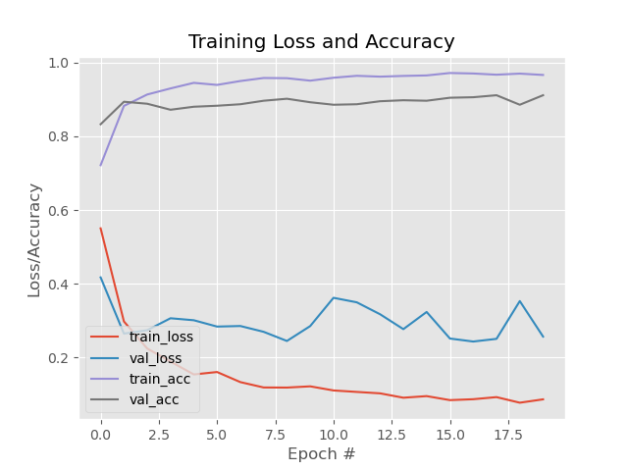
Model Evaluation
Notes:
Loss –error, accuracy was the metric I choice
Training acc– 98% Training loss – 8%
Validation acc- 90% Val loss – 28%

Slide 7
Model Building
Convolution Neural Network

Slide 8
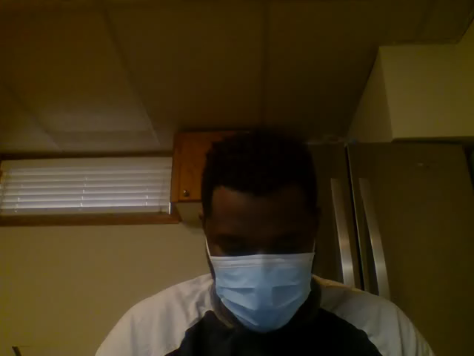
Mask Detection Model
Model detect a person face
Model detect if a person is on mask or not

Slide 9
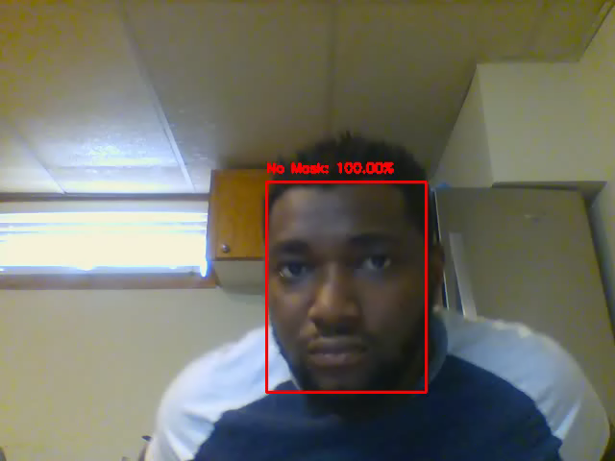
Proximity
Model calculate the distance between two or more faces
The distance line only comes up when the distance apart is less that the given threshold

Slide 10
Challenges

Slide 11
THANKS
Do you have any questions?
youremail@freepik.com
+91 620 421 83
yourcompany.com
Please keep this slide for attribution

